Slide 1
CHAPTER 3
COUNTING METHODS
(Part 2)
SCSI1013: Discrete Structures
Permutation & Combination
nzah@fc.utm.my 2014/2015 – Sem. 1

Slide 2
Permutations & Combinations
What’s the difference?
Consider these situations:
  “My fruit salad is a combination of apples, grapes and bananas”
    We don't care what order the fruits are in, they could also be "bananas, grapes and apples" or "grapes, apples and bananas", its the same fruit salad.
  “The combination to the safe was 472”
    Now we do care about the order. "724" would not work, nor would "247". It has to be exactly 4-7-2.

Slide 3
So, in Mathematics we use more precise language:
  If the order doesn't matter, it is a Combination.
    Combination means selection of things.
    The word selection is used, when the order of things has no importance.
  If the order does matter, it is a Permutation.
    Permutation means arrangement of things.
    The word arrangement is used, if the order of things is considered.

Slide 4
To help you to remember, think "Permutation ... Position"

Slide 5
Permutations

Slide 6
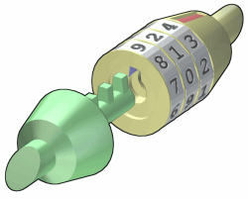
There are basically two types of permutation:
  Repetition is Allowed: such as the permutation lock (in picture). It could be "333".
  No Repetition: for example the first three people in a running race. You can't be first and second.

Slide 7

Permutation – No Repetition
In this case, you have to reduce the number of available choices each time.
For example, what order could 16 pool balls be in?
  After choosing, say, number "14" you can't choose it again.

Slide 8
So, your first choice would have 16 possibilities, and your next choice would then have 15 possibilities, then 14, 13, etc.
And the total permutations would be:
16 × 15 × 14 × 13 × ... = 20,922,789,888,000

Slide 9
But maybe you don't want to choose them all, just 3 of them, so that would be only:
16 × 15 × 14 = 3,360
In other words, there are 3,360 different ways that 3 pool balls could be selected out of 16 balls.

Slide 10
But how do we write that mathematically?
Answer: we use the "factorial function“
The factorial function (symbol: !) just means to multiply a series of descending natural numbers. Examples:
  4! = 4 × 3 × 2 × 1 = 24
  7! = 7 × 6 × 5 × 4 × 3 × 2 × 1 = 5,040
  1! = 1

Slide 11
So, if you wanted to select all of the billiard balls, the permutations would be:
16! = 20,922,789,888,000

Slide 12
A permutation of n distinct elements x₁, …, x_{n} is an ordering of the n elements x₁,..x_{n},
There are n! permutations of n elements
p(n) = n!
= n.(n-1).(n-2)…2.1

Slide 13
Example 1
There are 6 permutations of three elements
If the elements are denoted A, B, C, the six permutations are
  ABC, ACB, BAC, BCA, CAB, CBA
  3!= 3.2.1=6

Slide 14
Example 2
How many permutations of letters ABCDEF contain

Slide 15
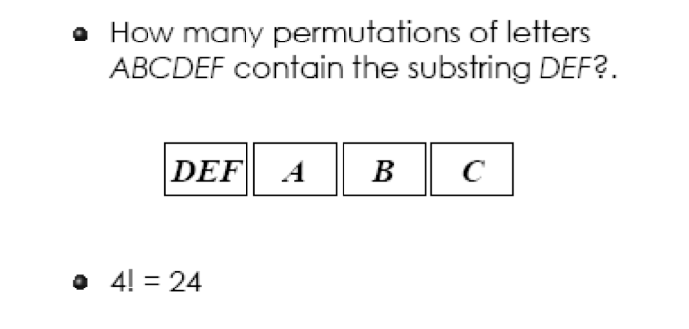
Example 2

Slide 16
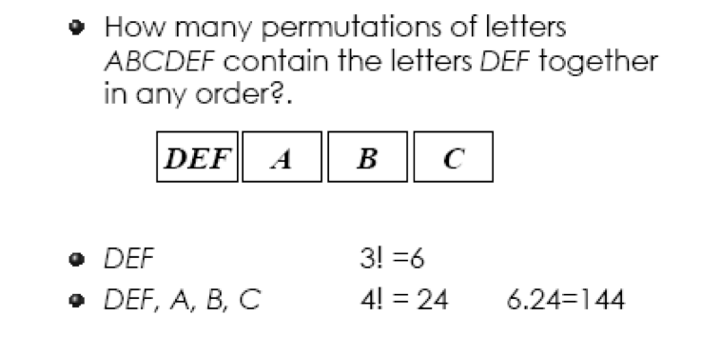
Example 3

Slide 17
Permutations - Circular Arrangement
The permutation in a row or along a line has a beginning and an end.
But there is nothing like beginning or end or first and last in a circular permutation.
In circular permutations, we consider one of the objects as fixed and the remaining objects are arranged as in linear permutation.

Slide 18
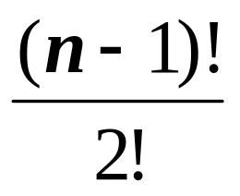
There are two cases of circular-permutations:
  If clockwise and anti clockwise orders are different, then total number of circular-permutations is given by (n-1)!
  If clockwise and anti clockwise orders are taken as not different, then total number of circular-permutations is given by

Slide 19

Let’s consider that 4 persons A,B,C, and D are sitting around a round table
Shifting A, B, C, D, one position in anticlock-wise direction, we get the following arrangements:-
......

Slide 20
Thus, we use that if 4 persons are sitting at a round table, then they can be shifted four times.
But these four arrangements will be the same, because the sequence of A, B, C, D, is same.

Slide 21

But if A, B, C, D, are sitting in a row, and they are shifted, then the four linear-arrangement will be different.

Slide 22
Hence, if we have ‘4’ things, then for each circular-arrangement, number of linear-arrangements is 4.
Similarly, if we have ‘n’ things, then for each circular-arrangement , number of linear–arrangement is n.

Slide 23
Hence, the number of circular permutations is
P_{n} = (n-1)!
The number is (n-1)! instead of the usual factorial, n! since all cyclic permutations of objects are equivalent because the circle can be rotated.

Slide 24
Thus, the number of permutations of 4 objects in a row = 4!
Where as the number of circular permutations of 4 objects is (4-1)! = 3!

Slide 25
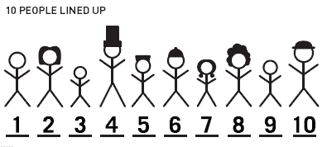
Example 1
Suppose we are expecting ten people for dinner.
How many ways can we seat them around a circular table?

Slide 26
Example 1 - Solution
First, let's think about how many ways we can line them up.
As we indicated above, there will be 10! ways to line up ten guests
10 for the first position, 9 for the second, 8 for the third, and so on.
10! = 10×9×8×7×6×5×4×3×2×1

Slide 27
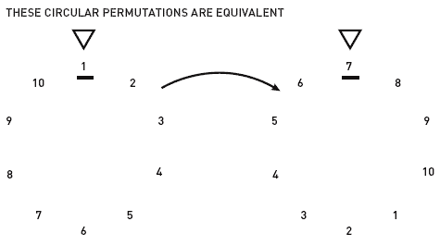
How does this change if they are seated around a circular table?

Slide 28
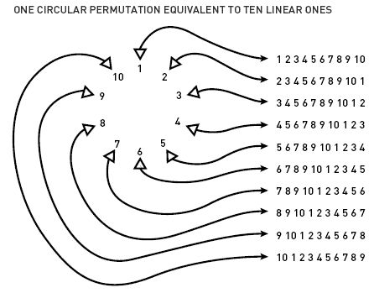
Notice that every circular arrangement corresponds to ten different linear arrangements.

Slide 29
Using our reasoning from before, we can see that the number of circular arrangements is equal to the number of linear arrangements, 10!, divided by ten to compensate for the fact that each circular permutation corresponds to ten different linear ones.
This gives as the number of ways to arrange ten guests around a table.
We can generalize this to say that n elements can be arranged in (n-1)! ways around a circle.

Slide 30
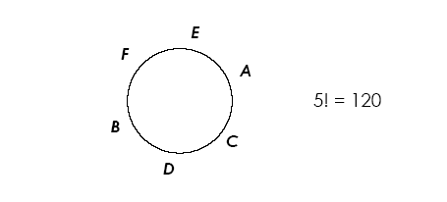
Example 2

Slide 31
More Examples
How many circular permutation can you form with 10 objects
(n-1)! = (10-1)!=9!=362880
How many ways can four boys and two girls be seated at a round table?
(n-1)!=(6-1)!=5!=120

Slide 32
Exercise
In how many ways can five people A, B, C, D, and E be seated around a circular table if
a) A and B must sit next to each other
b) A and B must not sit next to each other
c) A and B must be together and CD must be together

Slide 33
Solution
a) AB, C, D, E = (4-1)!=3!
AB switch places ; 3!.2!=12
b) (5-1)! ; consider five people = 4!
subtract with (a); 4!-12=12
c) 3 groups: AB, CD and E: 2!2!2!=8

Slide 34
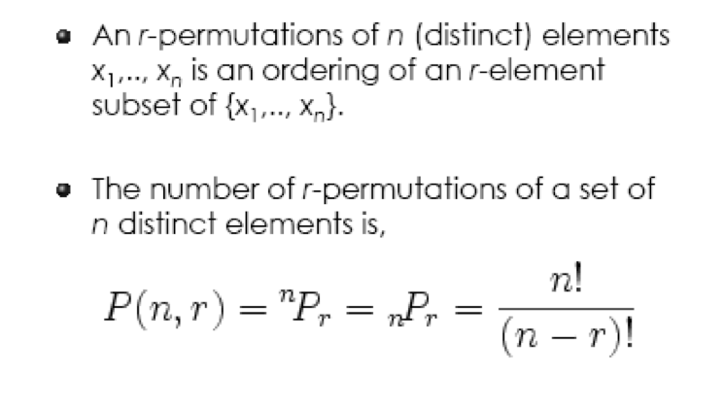
r-Permutations
(Permutations without repetition)

Slide 35
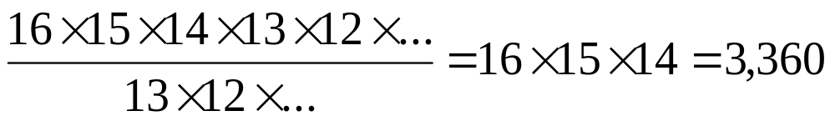
Example 1
Back to our billiard balls example.
If you wanted to select just 3, then you have to stop the multiplying after 14. How do you do that? There is a neat trick ... you divide by 13! ...
Do you see? 16! / 13! = 16 × 15 × 14

Slide 36
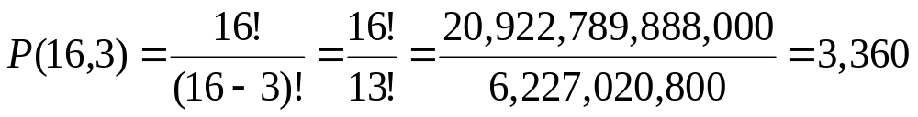
Our "order of 3 out of 16 pool balls example" would be:
which is just the same as:
16 × 15 × 14 = 3,360

Slide 37
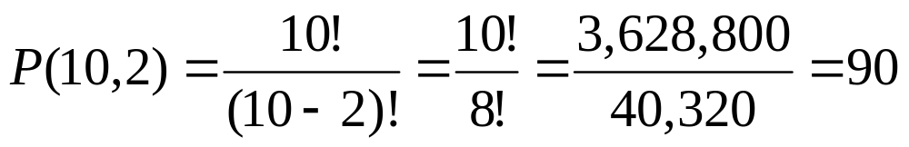
Example 2
How many ways can first and second place be awarded to 10 people?
which is just the same as:
10 × 9 = 90

Slide 38
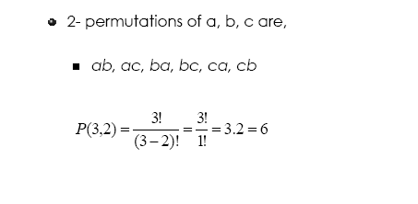
Example 3

Slide 39
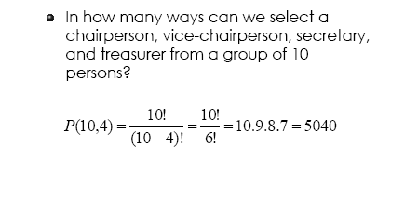
Example 4

Slide 40
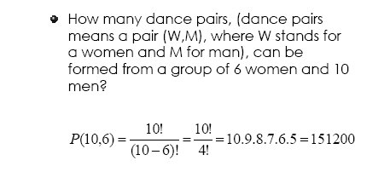
Example 5

Slide 41
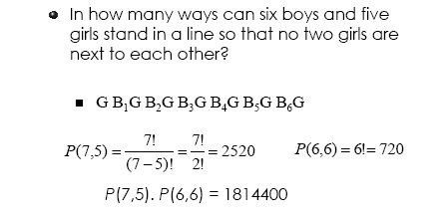
Example 6

Slide 42
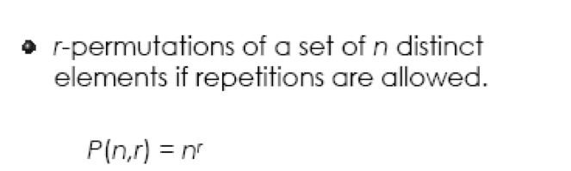
r-Permutations
(Permutations with repetitions allowed)

Slide 43
In other words:
  There are n possibilities for the first choice,
  THEN there are n possibilities for the second choice,
  and so on, multiplying each time.
Which is easier to write down using an exponent of r:
n × n × ... (r times) = n^{r}

Slide 44
Example 1
In the lock, there are 10 numbers to choose from (0,1,..9) and you choose 3 of them:
10 × 10 × ... (3 times)
= 10³
= 1,000 permutations

Slide 45
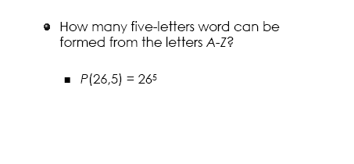
Example 2

Slide 46
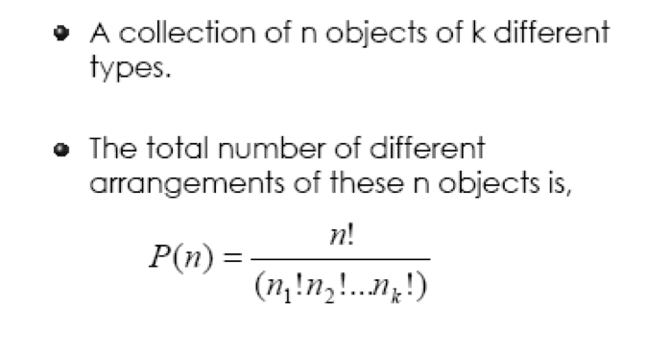
Permutations
(n objects, k different types)

Slide 47
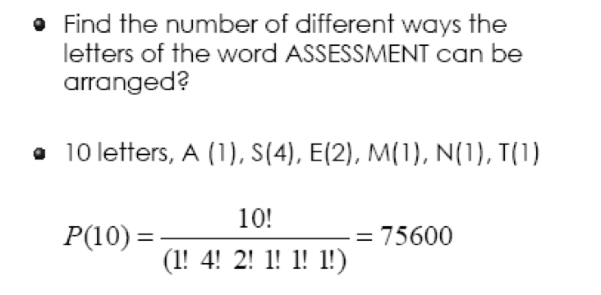
Example 1

Slide 48
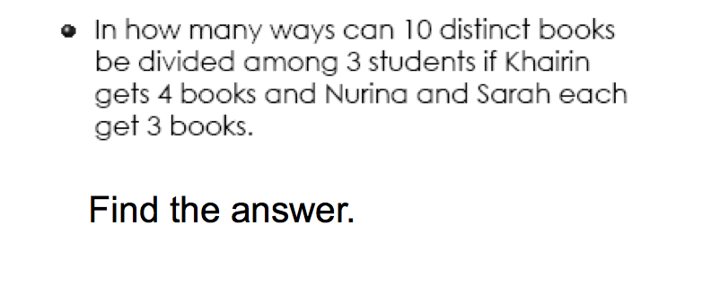
Exercise 1

Slide 49
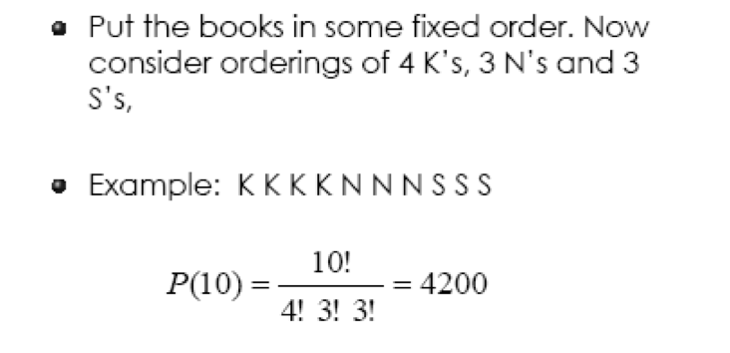
Exercise 1 - Solution

Slide 50
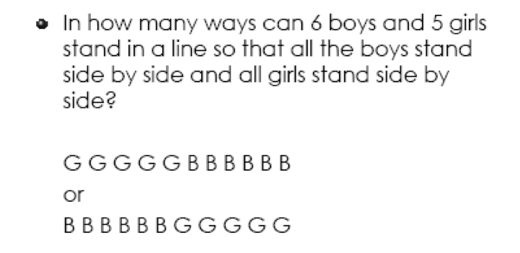
Exercise 2

Slide 51
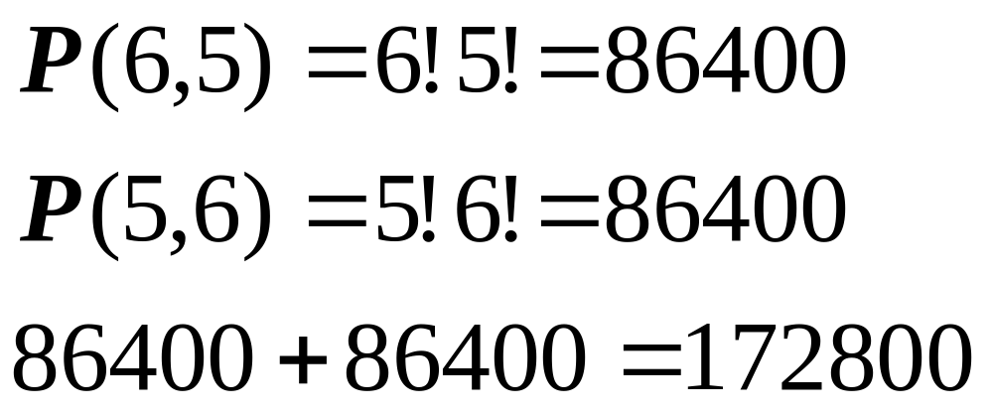
Exercise 2 - Solution

Slide 52
Exercise 3
How many words, with or without meaning can be made from the letters of the word MONDAY, assuming that no letter is repeated, if
    4 letters are used at a time ,
    all letters are used at a time
    iii) All letters are used but first letter is vowel
One hundred twelve people bought raffle tickets to enter a random drawing for three prizes. How many ways can three names be drawn for first prize, second prize, and third prize?
In how many ways can the letter of the word ‘JUDGE’ be arranged such that the vowels always come together?

Slide 53
Combinations

Slide 54
There are also two types of combinations (remember the order does not matter now):
Repetition is Allowed: such as coins in your pocket (5,5,5,10,10)
No Repetition: such as combination of subjects to enroll (Maths., English, Music)

Slide 55
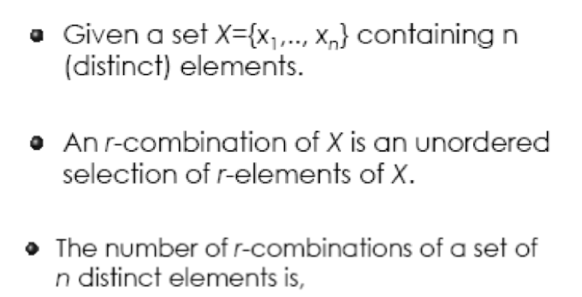
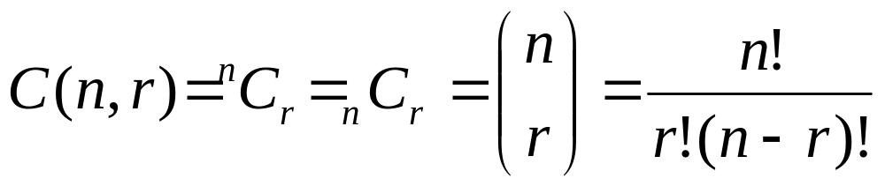
Combinations
(without Repetition)

Slide 56
Example 1
Go back to our pool ball example, let us say that you just want to know which 3 pool balls were chosen, not the order.
We already know that 3 out of 16 gave us 3,360 permutations.
But many of those will be the same to us now, because we don't care what order!

Slide 57
For example, let us say balls 1, 2 and 3 were chosen. These are the possibilities:
So, the permutations will have 6 times as many possibilities.
Order does matter | Order doesn't matter
1 2 3 1 3 2 2 1 3 2 3 1 3 1 2 3 2 1 | 1 2 3

Slide 58
In fact there is an easy way to work out how many ways "1 2 3" could be placed in order, and we have already talked about it.
The answer is:
3! = 3 × 2 × 1 = 6

Slide 59
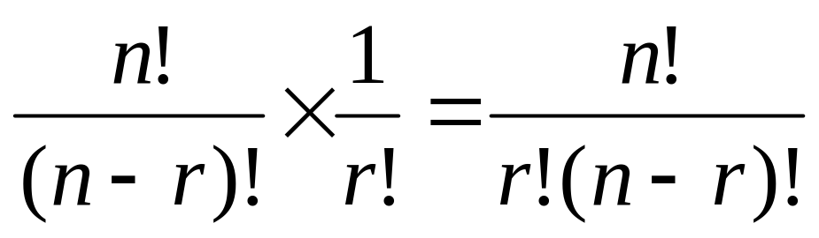
So, all we need to do is adjust our permutations formula to reduce it by how many ways the objects could be in order (because we aren't interested in the order any more):

Slide 60
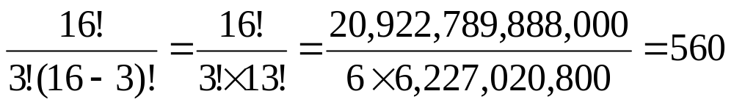
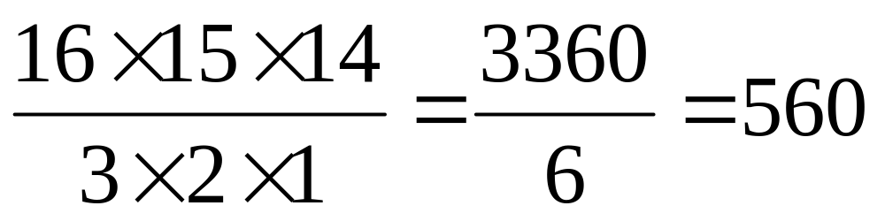
So, our pool ball example (now without order) is:
Or you could do it this way:

Slide 61
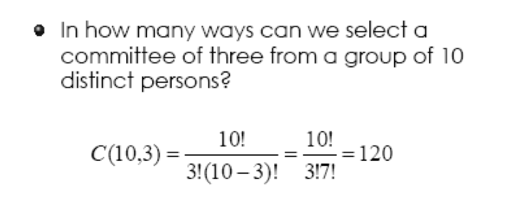
Example 2

Slide 62
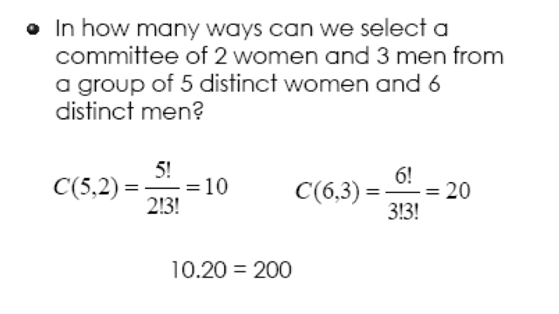
Example 3

Slide 63
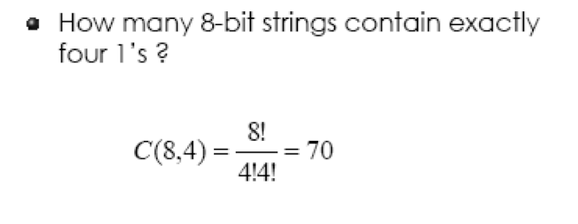
Example 4

Slide 64
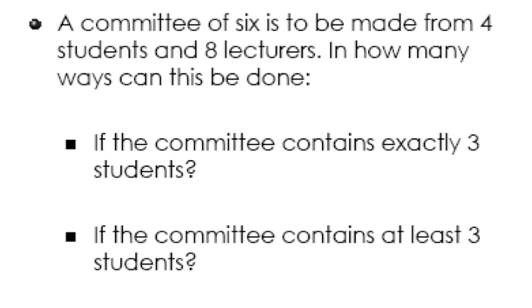
Example 5

Slide 65
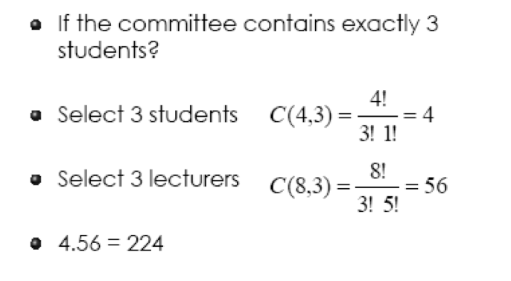
Example 5 - Solution

Slide 66
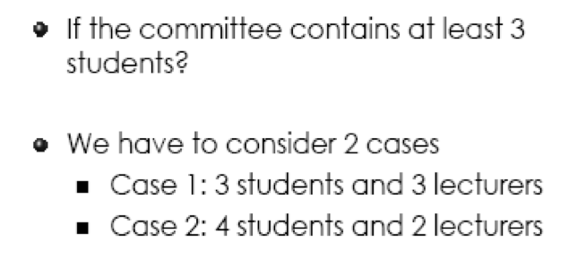

Slide 67
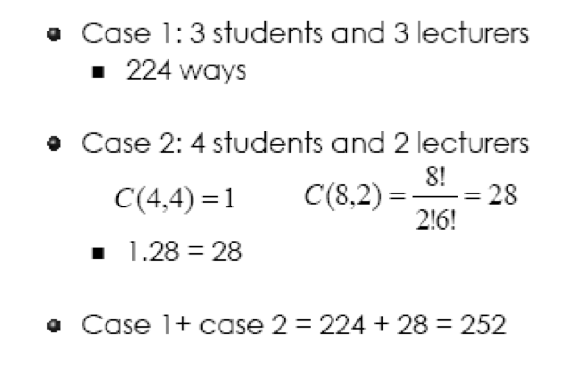

Slide 68
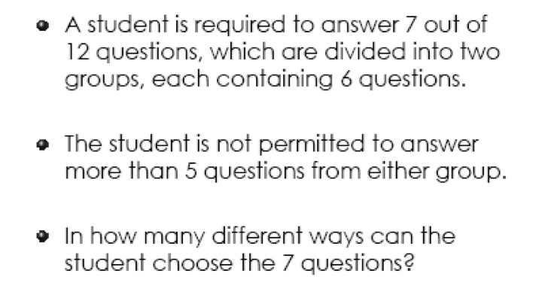
Example 6

Slide 69
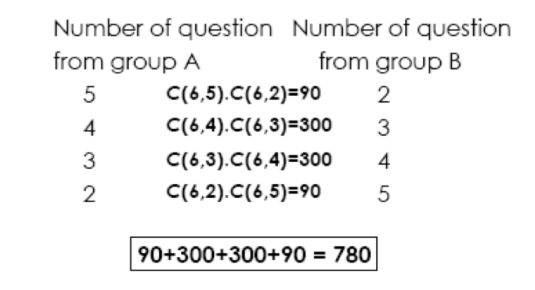
Example 6 - Solution

Slide 70
More exercises
Ahmad bought a machine to make fresh juice. He has five different fruits: strawberry, oranges, apples, pineapples and lemons. If he only use two fruits, how many different juice drinks can Ahmad make?
There are 25 people who work in an office together. Five of these people are selected to attend five different conferences. The first person selected will go to a conference in Hawaii, the second will go to New York, the third will go to San Diego, the fourth will go to Atlanta and the fifth will go to Nashville. How many such selection are possible
In a group of 6 boys and 4 girls, four children are to be selected. In how many different ways can they be selected such that at least one boy should be there?

Slide 71
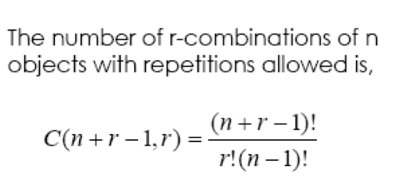
Combinations
(Repetition Allowed)
= { where n is the number of things/objects to choose from, and you choose r of them (repetition allowed, order doesn't matter) }

Slide 72

Example 1
Let say there are five flavors of ice-cream: banana, chocolate, lemon, strawberry and vanilla.
You can have three scoops.
How many variations will there be?

Slide 73
Let's use letters for the flavors:
{b, c, l, s, v}
Example selections would be
  {c, c, c} (3 scoops of chocolate)
  {b, l, v} (one each of banana, lemon and vanilla)
  {b, v, v} (one of banana, two of vanilla)
(And just to be clear: There are n=5 things to choose from, and you choose r = 3 of them. Order does not matter, and you can repeat!)

Slide 74
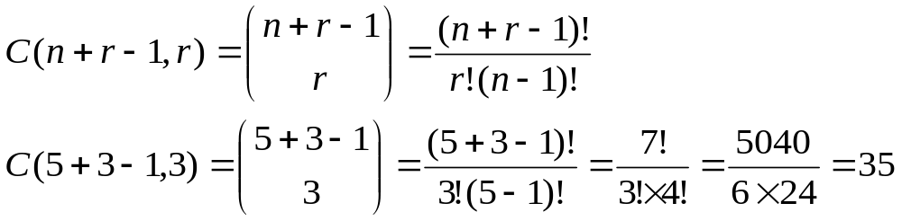
Solution:

Slide 75
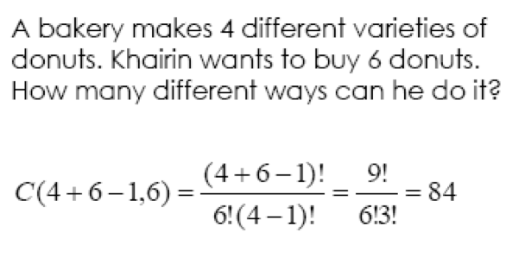
Example 2

Slide 76
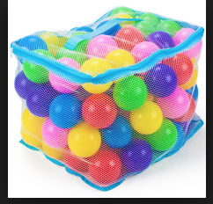
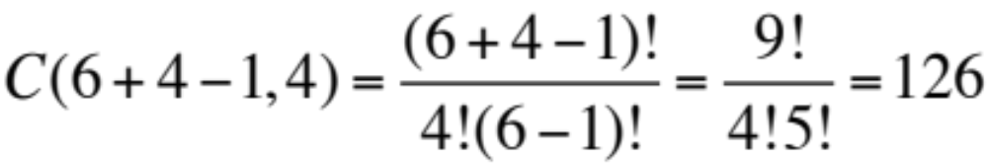
Example 3
There is a box containing identical blue, green, pink, yellow, red and dark blue balls. In how many ways we can select 4 balls?
Solution:

Slide 77
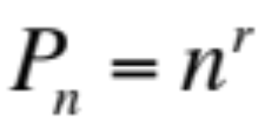
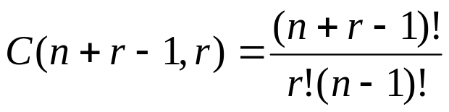
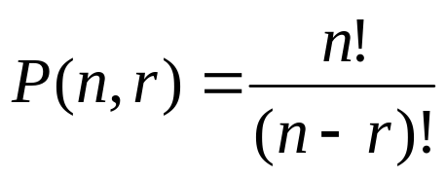
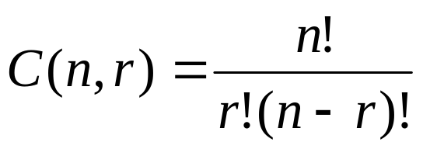
Summary
Which formula to use?
 | Order Matters (Permutations) | Order Does Not Matter (Combinations)
Repetition is allowed
Repetition is not allowed

Slide 78
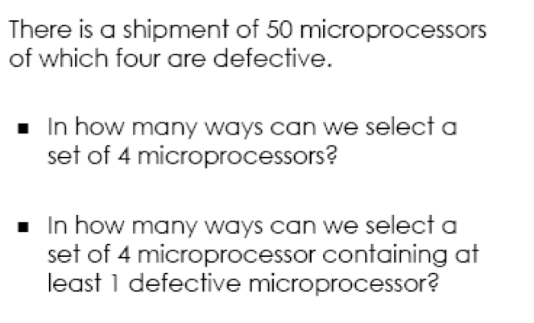
Exercise

Slide 79
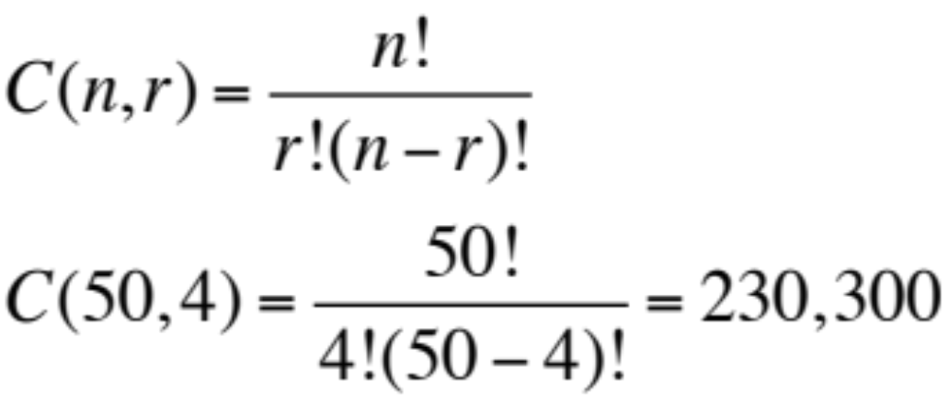
Exercise - Solution
i) In how many ways can we select a set of 4 microprocessors?
Order doesn’t matter, therefore use combination.
Repetition not allowed.

Slide 80
Exercise - Solution
ii) In how many ways can we select a set of 4 microprocessors containing at least I defective microprocessor?
Order doesn’t matter, therefore use combination.
Repetition not allowed.
Different tasks.
Not-Defective |  | Defective
3 | C(46,3).C(4,1) =15180*4 = 60720 | 1
2 | C(46,2).C(4,2) =1035*6 = 6210 | 2
1 | C(46,1).C(4,3) =46*4 = 184 | 3
0 | C(46,0).C(4,4) =1*1 = 1 | 4
60720+6210+184+1 = 67115

